Slide 1
A core Course on Modeling
Introduction to Modeling
0LAB0 0LBB0 0LCB0 0LDB0
c.w.a.m.v.overveld@tue.nl
v.a.j.borghuis@tue.nl
S.14

Slide 2
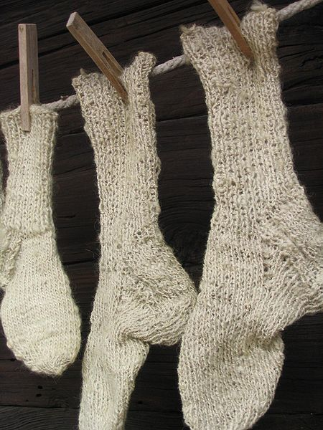
Running example:
the secret life of socks
Purpose: the model should …
help decide which socks to wear
help decide when to wash socks
http://commons.wikimedia.org/wiki/File:Socks_III.jpg
Notes:
2

Slide 3
Step 1: conceptual model with properties:
mySocks=[pair1:pairOfSocks,
pair2:pairOfSocks,
...]
pairOfSocks:[lSock:sock,rSock:sock];
sock:[where:{closet,on,wash},
hygiene:{clean... dirty}];
pair1.lSock.where == closet
pair2.rSock.where == on
pair3.lSock.hygiene == dirty
pair2.rSock.where == wash
means: left sock of pair1 is stored away
means: I am wearing the right sock of pair2
means: the left sock of pair3 is dirty
means: the right sock of pair 2 is being washed
Notes:
3

Slide 4
Describe processes: statecharts
Both socks of pair1
are in the closet
and clean
Right sock of pair1
is in the closet;
I wear left sock of pair1
Right sock of pair1
is in the closet;
I wear left sock of pair1;
it is somewhat dirty
put on left sock of pair1
left sock gets dirty
Notes:
4
Do we need to build a completely new model from scratch whenever something in the modeled system changes?
Inefficient!
intuition: describe a process by relating states (=‘freezes’ or ‘snapshots’) of the system

Slide 5
State = all properties in the conceptual model
with their values
State space = the collection of all states
A behavior = a route through statespace
A process = the collection of behaviors
Notes:
5

Slide 6
Left sock of pair1
is being washed
Right sock of pair1
is in the closet
Left sock of pair1
is being washed
Right sock of pair1
is in the closet
Left sock of pair1
is in the closet;
I wear right sock of pair1
Both socks of pair1
are in the closet
and clean
Right sock of pair1
is being washed
left sock of pair1
is in the closet
Right sock of pair1
is in the closet;
I wear left sock of pair1;
it is somewhat dirty
Both socks of pair1
are in the closet
and clean
Right sock of pair1
is in the closet;
I wear left sock of pair1
I wear both socks of pair1;
left sock is dirtier than
right sock
I wear right sock of pair2;
I wear left sock of pair1;
left sock is somewhat dirty
Notes:
6

Slide 7
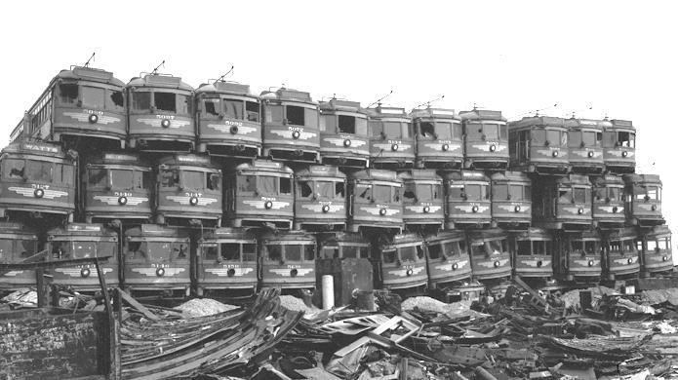
A real-life example: controlling a parking garage
Notes:
7

Slide 8
With n quantities, each m_{i} values,
nr states = Π_{i=1 … n} m_{i}.
Number of behaviors
with p steps = Π_{j=1 … p} Π_{i=1 … n} m_{i}.
State and process explosion
http://www.clipartlord.com/wp-content/uploads/2012/10/bomb-explosion-300x234.png
Notes:
8
State = all properties in the conceptual model with their values
State space = the collection of all states
A behavior = a route through statespace
A process = collection of behaviors of a system

Slide 9
For 1 pair of socks,
pairOfSocks: [lSock: sock, rSock: sock];
sock: [where: {closet,on,wash}, hygiene:{clean... dirty}],
say 10 steps from clean ... dirty
the state space contains
3 x 10 x 3 x 10 = 900 states.
For 2 pair: 900 x 900 = 810000 states, etc.
Notes:
9

Slide 10
QUIZ
For 1 pair of socks,
pairOfSocks: [lSock: sock, rSock: sock];
sock: [where: {closet,on,wash}, hygiene:{clean... dirty}],
say 10 steps from clean ... dirty
the state space contains
3 x 10 x 3 x 10 = 900 states.
For 2 pair: 900 x 900 = 810000 states, etc.
A sock might also contain a hole.
What is the consequence for the statespace of a pair of socks if we take this into account?
Notes:
10

Slide 11
For 1 pair of socks,
pairOfSocks: [lSock: sock, rSock: sock];
sock: [where: {closet,on,wash}, hygiene:{clean... dirty}],
say 10 steps from clean ... dirty
the state space contains
3 x 10 x 3 x 10 = 3600 states.
For 2 pair: 900 x 900 = 810000 states, etc.
Parking garage: 10⁸⁰ states (incl. folded cars!)
Notes:
11

Slide 12
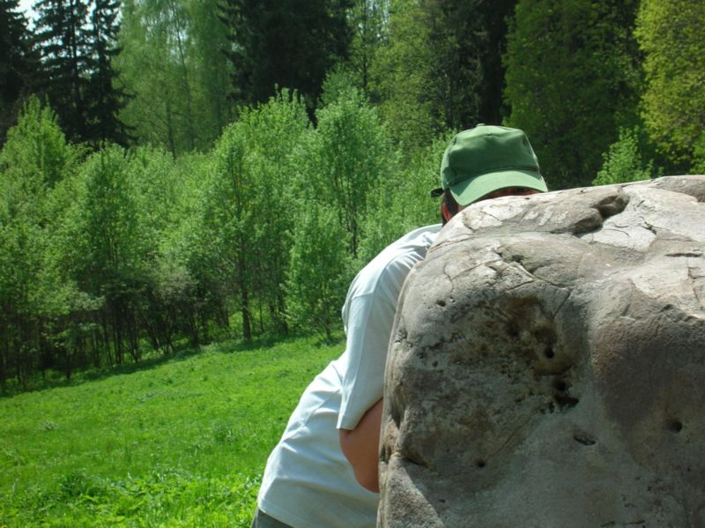
Idea: hiding and exposing
quantities or
values
12
http://commons.wikimedia.org/wiki/File:%D0%AF_%D0%B7%D0%B0_%D0%BA%D0%B0%D0%BC%D0%BD%D0%B5%D0%BC.jpg
Notes:
12

Slide 13
Decrease amount of states:
distinguish exposed and hidden
quantities or values,
focus on the exposed ones.
Notes:
13
Exposed quantities or values: externally visible or accessible
Hidden quantities or values: internal behaviour, may help explaining seemingly uncausal exposed behavior
Which quantities need exposure: depends on purpose of the model
Which quantities may be hidden: as much as possible to simplify model

Slide 14
what to hide? → purpose
to decide washing:
value ‘closet’ can be hidden for property ‘where’;
to decide which socks to wear:
hygiene values between ‘clean’ and ‘dirty’ can be hidden. Only ‘clean’ and ‘not clean’ matter.
Notes:
14
purpose asks for something that mimics the
physical pen,
hence the choices for which
properties are visible and which are not

Slide 15
Example: 1 pair of socks
lSock.where==on
rSock.where==on
lSock.hygiene==clean
rSock.hygiene==clean
wearing
lSock.where==wash
rSock.where==wash
lSock.hygiene==dirty
rSock.hygiene==dirty
washing
Notes:
15
Assume that we don’t put socks in the closet, and we don’t bother to distinguish various levels of dirty.

Slide 16
Example: 1 pair of socks
Too naive:
ignores closet-state
ignores socks can get separated
ignores multiple pairs of socks
Notes:
16
The challenge is to find a statechart that is
more subtle than merely the two states version
does not have to resort on full state space

Slide 17
First: look at 1 sock
where==closet
hygiene==clean
where==wash
hygiene!=clean
where==closet
hygiene!=clean
where==wash
hygiene==clean
where==on
hygiene==clean
where==on
hygiene!=clean
Notes:
17

Slide 18
First: look at 1 sock: change 1 property at once
where==closet
hygiene==clean
where==wash
hygiene!=clean
where==closet
hygiene!=clean
where==wash
hygiene==clean
where==on
hygiene==clean
where==on
hygiene!=clean
Notes:
18

Slide 19
First: look at 1 sock: change at least one property
where==closet
hygiene==clean
where==wash
hygiene!=clean
where==closet
hygiene!=clean
where==wash
hygiene==clean
where==on
hygiene==clean
where==on
hygiene!=clean
Notes:
19

Slide 20
First: look at 1 sock: change at least one property
where==closet
hygiene==clean
where==wash
hygiene!=clean
QUIZ
where==closet
hygiene!=clean
Which state transitions are forbidden if at least one property has to change?
where==wash
hygiene==clean
where==on
hygiene==clean
where==on
hygiene!=clean
Notes:
20

Slide 21
First: look at 1 sock: change at least one property
where==closet
hygiene==clean
where==wash
hygiene!=clean
where==closet
hygiene!=clean
where==wash
hygiene==clean
where==on
hygiene==clean
where==on
hygiene!=clean
Notes:
21

Slide 22
First: look at 1 sock: transitions in both directions are distinct
where==closet
hygiene==clean
where==wash
hygiene!=clean
where==closet
hygiene!=clean
where==wash
hygiene==clean
where==on
hygiene==clean
where==on
hygiene!=clean
Notes:
22

Slide 23
First: look at 1 sock: transitions in both directions are distinct
where==closet
hygiene==clean
where==wash
hygiene!=clean
where==closet
hygiene!=clean
where==wash
hygiene==clean
where==on
hygiene==clean
where==on
hygiene!=clean
Notes:
23

Slide 24
First: look at 1 sock: socks don’t get dirty unless being worn
where==closet
hygiene==clean
where==wash
hygiene!=clean
where==closet
hygiene!=clean
where==wash
hygiene==clean
where==on
hygiene==clean
where==on
hygiene!=clean
Notes:
24

Slide 25
First: look at 1 sock: socks only get clean by washing
where==closet
hygiene==clean
where==wash
hygiene!=clean
where==closet
hygiene!=clean
where==wash
hygiene==clean
where==on
hygiene==clean
where==on
hygiene!=clean
Notes:
25

Slide 26
First: look at 1 sock: socks only get clean by washing
where==closet
hygiene==clean
where==wash
hygiene!=clean
QUIZ
where==closet
hygiene!=clean
Which state transitions are forbidden if socks only get clean by washing?
where==wash
hygiene==clean
where==on
hygiene==clean
where==on
hygiene!=clean
Notes:
26

Slide 27
First: look at 1 sock: socks only get clean by washing
where==closet
hygiene==clean
where==wash
hygiene!=clean
where==closet
hygiene!=clean
where==wash
hygiene==clean
where==on
hygiene==clean
where==on
hygiene!=clean
Notes:
27

Slide 28
First: look at 1 sock: only put on clean socks
where==closet
hygiene==clean
where==wash
hygiene!=clean
where==closet
hygiene!=clean
where==wash
hygiene==clean
where==on
hygiene==clean
where==on
hygiene!=clean
Notes:
28

Slide 29
First: look at 1 sock: don’t put dirty socks in the closet
where==closet
hygiene==clean
where==wash
hygiene!=clean
where==closet
hygiene!=clean
where==wash
hygiene==clean
where==on
hygiene==clean
where==on
hygiene!=clean
Notes:
29

Slide 30
First: look at 1 sock: don’t put dirty socks in the closet
where==closet
hygiene==clean
where==wash
hygiene!=clean
QUIZ
where==closet
hygiene!=clean
Which state transitions are forbidden if we don’t put dirty socks in the closet?
where==wash
hygiene==clean
where==on
hygiene==clean
where==on
hygiene!=clean
Notes:
30

Slide 31
First: look at 1 sock: don’t put dirty socks in the closet
where==closet
hygiene==clean
where==wash
hygiene!=clean
where==closet
hygiene!=clean
where==wash
hygiene==clean
where==on
hygiene==clean
where==on
hygiene!=clean
Notes:
31

Slide 32
First: look at 1 sock: don’t put clean socks in the wash
where==closet
hygiene==clean
where==wash
hygiene!=clean
where==closet
hygiene!=clean
where==wash
hygiene==clean
where==on
hygiene==clean
where==on
hygiene!=clean
Notes:
32

Slide 33
First: look at 1 sock: don’t put worn socks into the closet
where==closet
hygiene==clean
where==wash
hygiene!=clean
where==closet
hygiene!=clean
where==wash
hygiene==clean
where==on
hygiene==clean
where==on
hygiene!=clean
Notes:
33

Slide 34
First: look at 1 sock: some states are unreachable
where==closet
hygiene==clean
where==wash
hygiene!=clean
where==closet
hygiene!=clean
where==wash
hygiene==clean
where==on
hygiene==clean
where==on
hygiene!=clean
Notes:
34

Slide 35
First: look at 1 sock: the life cycle for a single sock
where==closet
hygiene==clean
where==wash
hygiene!=clean
where==closet
hygiene!=clean
where==wash
hygiene==clean
where==on
hygiene==clean
simulate
where==on
hygiene!=clean
Notes:
35

Slide 36
Next: look at 2 socks: the life cycle for a pair of socks
where==closet
hygiene==clean
where==wash
hygiene!=clean
where==closet
hygiene!=clean
pair1.rSock
where==wash
hygiene==clean
where==on
hygiene==clean
where==closet
hygiene==clean
where==on
hygiene!=clean
where==wash
hygiene!=clean
where==closet
hygiene!=clean
pair1.lSock
where==wash
hygiene==clean
where==on
hygiene==clean
where==on
hygiene!=clean
Notes:
36

Slide 37
Next: look at 2 socks: the life cycle for a pair of socks
QUIZ
where==closet
hygiene==clean
In which state transition(s) for lSock should we inspect the state of rSock, and vice versa?
where==wash
hygiene!=clean
where==closet
hygiene!=clean
pair1.rSock
where==wash
hygiene==clean
where==on
hygiene==clean
where==closet
hygiene==clean
where==on
hygiene!=clean
where==wash
hygiene!=clean
where==closet
hygiene!=clean
pair1.lSock
where==wash
hygiene==clean
where==on
hygiene==clean
where==on
hygiene!=clean
Notes:
37

Slide 38
Next: look at 2 socks: the life cycle for a pair of socks
only allowed if pair1.rSock.hygiene == clean
where==closet
hygiene==clean
where==wash
hygiene!=clean
where==closet
hygiene!=clean
pair1.rSock
where==wash
hygiene==clean
where==on
hygiene==clean
where==closet
hygiene==clean
where==on
hygiene!=clean
where==wash
hygiene!=clean
where==closet
hygiene!=clean
pair1.lSock
where==wash
hygiene==clean
where==on
hygiene==clean
only allowed if pair1.lSock.hygiene == clean
where==on
hygiene!=clean
Notes:
38

Slide 39
Next: look at 2 socks: the life cycle for a pair of socks
QUIZ
only allowed if pair1.rSock.hygiene == clean
where==closet
hygiene==clean
Thusfar, we only looked at the behavior for one pair of socks.
How do further pairs of socks get involved in the process?
where==wash
hygiene!=clean
where==closet
hygiene!=clean
pair1.rSock
where==wash
hygiene==clean
where==on
hygiene==clean
where==closet
hygiene==clean
where==on
hygiene!=clean
where==wash
hygiene!=clean
where==closet
hygiene!=clean
pair1.lSock
where==wash
hygiene==clean
where==on
hygiene==clean
only allowed if pair1.lSock.hygiene == clean
where==on
hygiene!=clean
Notes:
39

Slide 40
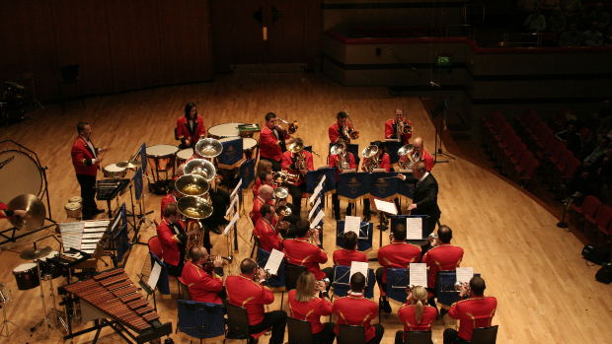
Statecharts:
Communicating and Synchronizing processes
http://www.morguefile.com/archive?referrer=1660250&srh_field=wine+tasting#/?q=orchestra&photo_lib=morgueFile
Notes:
40

Slide 41
Statecharts:
Simulate processes
Analyse processes
Optimize processes
Verify: desired states are reached?
Verify : forbidden states cannot be reached?
Notes:
41

Slide 42
Statecharts:
Simulate processes
Analyse processes
Optimize processes
Verify: desired states are reached?
Verify : forbidden states cannot be reached?
Reduce processes (hiding / exposing)
Notes:
42
predict: see when/if a particular state occurs (or: a state with a certain property), or examine the properties of a given (future) state
specify: give desired proporties of some final state
verify: check that a certain state cannot occur
analyse if there no are deadlocks (=dead end routes)
analyse if states that should be reached can be reached
analyse if states that should be reached in some order are reached in that order
analyse if occurring transitions are permitted (while monitoring a system)

Slide 43
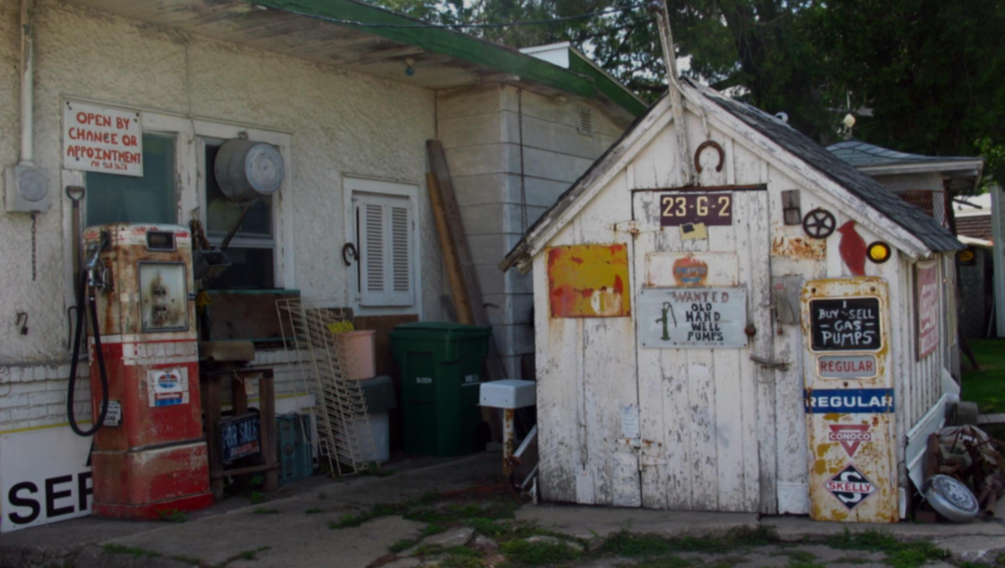
http://www.sxc.hu/browse.phtml?f=download&id=191768
Statecharts: ...
... what about the automated garage?
model was reduced from 10⁸⁰ to 3.3 x 10⁶ states… and could be analysed by computer
Notes:
43

Slide 44
Summary:
state: properties and values in a certain situation
transition: go from one state to a next
state space: collection of states
behavior: route through state space
process: collection of behaviors
state explosion: processes amount to very many states
hiding / exposing: simplifying process by reducing values or properties (given a purpose)
state chart: formal representation of process
Notes:
44

